Slide 1

Bias Analysis & Mitigation in NLP
Understanding and Addressing Bias
in Language Models
Ashly Ann Jo
Research Scholar, FACTS-H Lab
Notes:
Welcome everyone. I’m Ashly Ann Jo, a research scholar at the FACTS-H Lab. Today, we’ll explore how bias can creep into Natural Language Processing (NLP) systems, how we can detect it, and most importantly, how we can reduce or remove it. Our focus will be practical and research-driven, with a real-world case study at the end.

Slide 2
Agenda
Bias in Word Embeddings
Detecting Gender, Racial & Religious Bias
Contextual Bias in BERT
Bias Mitigation Techniques
Case Study: Sentiment & Fairness
Notes:
Here’s a quick overview of what we’ll cover:
What is bias in NLP and why it matters.
How bias appears in word embeddings.
Methods to detect gender, racial, and religious bias.
How modern models like BERT show contextual bias.
Techniques to reduce or eliminate bias.
A case study in sentiment analysis and fairness. We’ll finish with a hands-on session to apply what we learn.

Slide 3
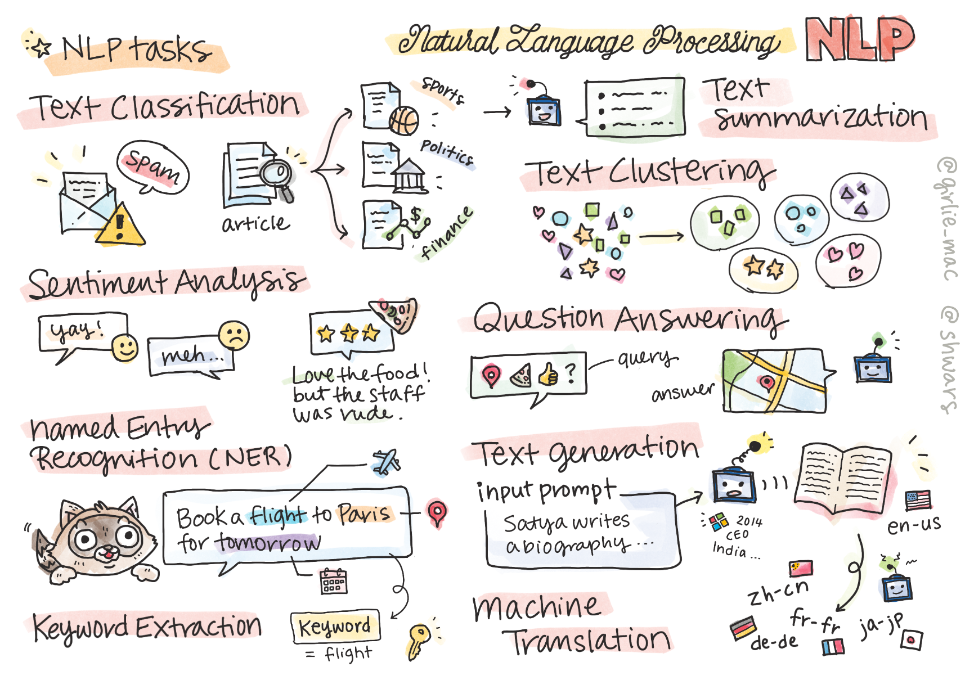
Introduction to Bias in NLP
Introduction to Bias in NLP
NLP models learn from biased human data.
Bias can lead to unfair or discriminatory outputs.
Goal: Detect and mitigate unintended bias in NLP systems.
NLP models learn from biased human data.
Bias can lead to unfair or discriminatory outputs.
Goal: Detect and mitigate unintended bias in NLP systems.
Notes:
NLP models learn by looking at lots of text from the internet and people. But human language often includes hidden biases and stereotypes. So, when the model learns from this data, it also picks up those biases. This can lead to unfair or biased results. That’s why it’s important to find and fix these problems—so our NLP systems are fair and trustworthy.

Slide 4
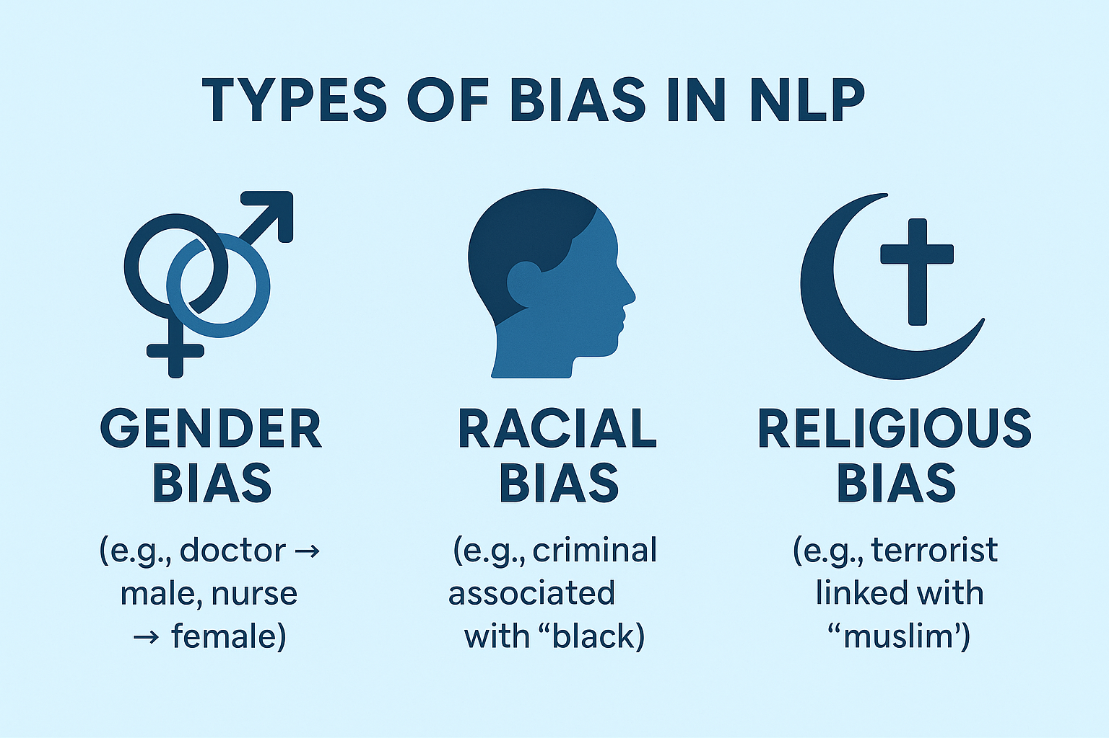
Types of Bias in NLP
Gender Bias – e.g., doctor → male, nurse → female
Racial Bias – e.g., criminal associated with 'black'
Religious Bias – e.g., terrorist linked with 'muslim'
Notes:
There are different types of bias that can show up in NLP:
Gender bias: For example, the word "doctor" is often linked with "male", and "nurse" with "female", even though either profession can belong to any gender.
Racial bias: Words like "criminal" might be associated more with "black"—this is clearly problematic.
Religious bias: Terms like "terrorist" are often unfairly linked with "Muslim". These stereotypes can reinforce harmful assumptions when NLP systems are used in real-world applications.

Slide 5
WEAT - Measuring Bias
WEAT: Word Embedding Association Test
Compare cosine similarity of target words
Professions vs. male/female group words
Notes:
To measure bias, we use a method called WEAT—the Word Embedding Association Test. It works like this:
We take two groups of target words, say, professions like "engineer", "nurse", etc.
Then we compare how similar these words are—mathematically—using cosine similarity to gendered terms like "he" and "she".
If professions are more similar to male terms than female ones, that’s evidence of gender bias. This gives us a way to quantify bias in word embeddings.

Slide 6
Bias Mitigation Techniques
Neutralize: remove gender direction from neutral words
Equalize: align explicitly gendered word pairs
Adversarial debiasing: reduce model reliance on bias
Notes:
Once we detect bias, we can try to fix it. Here are three main techniques:
Neutralize – This removes gender information from words that shouldn’t have it. For instance, the word "doctor" should be neutral, not skewed toward male or female.
Equalize – This aligns gendered word pairs like "king" and "queen" so they’re treated equally in the embedding space.
Adversarial Debiasing – This is a machine learning technique that trains the model to minimize its dependence on biased patterns in the data. Each of these techniques has pros and cons depending on the task.

Slide 7
Case Study: Bias Mitigation in Sentiment Analysis
Dataset with gender-labeled text
Applied bias-corrected embeddings
Sentiment analysis using TextBlob
Compared bias pre- and post-mitigation
Notes:
We took a dataset with gender-labeled text and applied a bias mitigation technique to the word embeddings.
Then we ran sentiment analysis using TextBlob before and after bias correction.
The goal was to see if the sentiment scores were affected by gender terms—and whether our mitigation helped remove that bias.
This case study shows how bias correction can improve fairness in real applications.

Slide 8
Hands-On Sessions
Combined Bias
2. Bias Mitigation NLP
Notes:
There are two parts:
Combined Bias Analysis – where we’ll see how different types of bias can overlap.
Bias Mitigation in NLP – where you’ll apply some of the techniques we discussed today. This will help reinforce the concepts and give you experience working with real data and tools.

